Slide 1
Linux & Shell Programming
CAP448
Compiled by:
Pallavi B. Vyas
Asstt. Prof.
UID 18751
Compiled by: Pallavi B. Vyas

Slide 2
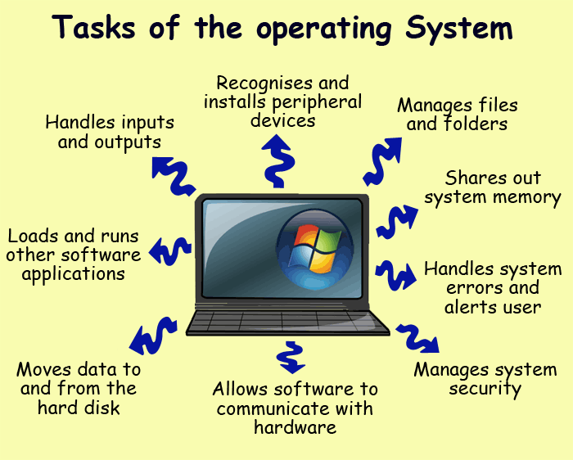
Operating System
Compiled by: Pallavi B. Vyas

Slide 3
Origin….
By Dennis ritche and Ken thompson
AT&T labs
Multiuser
Compiled by: Pallavi B. Vyas

Slide 4
Who discovered?
Linus Torvalds
MIT LAb
Compiled by: Pallavi B. Vyas

Slide 5
Comparison
Table 1.1: Sales of Popular Desktop Operating Systems
Operating System | 1997 | 2001
Windows 95/98 | 69.4% | 65.0%
Windows NT Workstation | 9.2 | 26.2
DOS with Windows 3.x | 7.7 | 0.3
MacOS | 4.6 | 1.9
Linux | 2.4 | 4.2
DOS without Windows | 2.3 | 0.3
Unix | 1.0 | 0.5
OS/2 Warp | 0.8 | 1.2
Other | 2.7 | 0.5
Compiled by: Pallavi B. Vyas

Slide 6
How Linux is Different
Linux is a cross-platform operating system
Linux is free, in two senses
Linux has attractive features and performance.
Compiled by: Pallavi B. Vyas

Slide 7
Table 1.2: The History of Linux
Year | Version | Users | Kernel size (Bytes) | Milestone(s)
1991 | 0.01 | 100 | 63,362 | Linus Torvalds writes Linux kernel
1992 | 0.99 | 1000 | 431,591 | GNU software integrated with Linux kernel, producing a fully functional operating system
1993 | 0.99 | 20,000 | 937,917 | High rate of code contributions prompts Linus to delegate code review responsibility
1994 | 1.0 | 100,000 | 1,016,601 | First production release
1995 | 1.2 | 500,000 | 1,850,182 | Linux adapted to non-Intel processors
1996 | 2.0 | 1,500,000 | 4,718,270 | Linux supports multiple processors, IP masquerading, and Java
1999 | 2.2 | 7,500,000 | 10,600,000[ 4] | Linux growth rate exceeds that of Microsoft Windows NT
Compiled by: Pallavi B. Vyas

Slide 8
Table 1.3: Popular Linux Distributions and Their Web Home Pages
Distribution | Home Page
Caldera OpenLinux | http://www.caldera.com/
Debian Linux | http://www.debian.org/
Slackware Linux | http://www.cdrom.com/titles/os/slackwar.htm/
Red Hat Linux | http://www.redhat.com/
SuSE. Linux | http://www.suse.com/
Compiled by: Pallavi B. Vyas

Slide 9
GUI
X windows(MIT)
First, X integrates with a computer network,
Second, X lets you configure its look and feel to an amazing degree.
Compiled by: Pallavi B. Vyas

Slide 10
Table 1.4: Linux Features and Performance Comparison
Characteristic | Linux | Windows NT | Solaris
Range of compatible hardware | Very wide | Modest | Narrow
Minimal hardware | 386 PC | 486 PC | Pentium
Representative cost of hardware | $200 | $1300 | $1600
Average downtime | Very low | As low as 30 min./week | Very low
Performance | High | Comparable to Linux | Half of Linux to same as Linux
Multi-processing capabilities | Excellent | Modest | Excellent
IP Security (IPSec) | Yes | Planned | 1999
IPv6 | Available | Privately demonstrated | Beta
Overall user satisfaction, per Datapro | Highest | Lowest | Medium
Source code readily available | Yes | No | No
Installed base | Millions | Millions | Hundreds of thousands
Compiled by: Pallavi B. Vyas

Slide 11
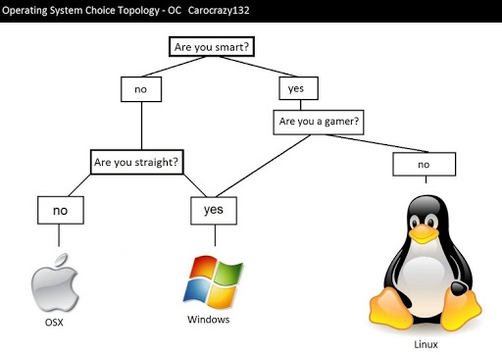
Why to choose Linux?
You want a stable and reliable computing platform.
You want a high performance computing platform.
You need a low-cost or free operating system
You're a heavy network or Internet user.
You want to learn Unix or TCP/IP networking.
You seek an alternative to Microsoft's vision of computing's future.
You want to enjoy enhanced peer esteem.
You're scared of computers.
You don't like to learn.
Compiled by: Pallavi B. Vyas

Slide 12
Components of Linux Operating System
OS is a STACK of software.
  Kernel
  System Library
  System Utility
  Development tools
Compiled by: Pallavi B. Vyas

Slide 13
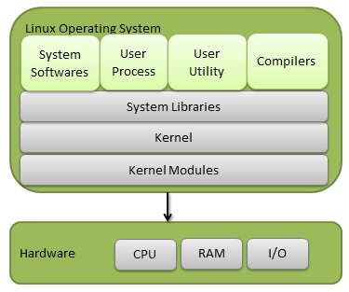
Linux OS
Compiled by: Pallavi B. Vyas

Slide 14
Job of Kernel
A kernel has generally four basic responsibilities:
1) (I/O) device management
2) memory management
3) process management
4) File management
* handling system calls
*User mode vs Kernel mode.
Compiled by: Pallavi B. Vyas

Slide 15
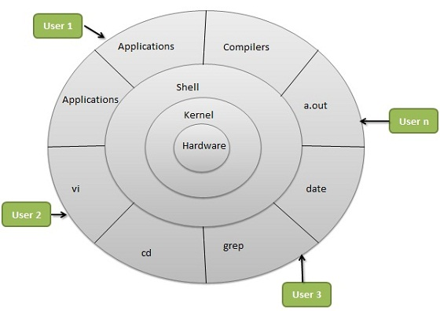
Architecture
Compiled by: Pallavi B. Vyas

Slide 16
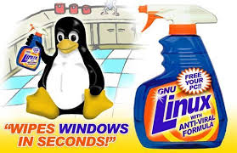
Myths…..
Linux is hard to install
There is no support for Linux
Linux is free software, so security holes are easily found
Linux is non-graphical
I cannot run my software under Linux
Linux is not secure
Linux is an alternative for Microsoft Windows
Linux is anti-Microsoft
Compiled by: Pallavi B. Vyas

Slide 17
Weakness…….
Games support is slowly progressing
Recent hardware isn't quickly adopted within Linux
Compiled by: Pallavi B. Vyas

Slide 18

Virtualization
Virtualization deals with “extending or replacing an existing interface so as to mimic the behavior of another system”
Virtual system examples: virtual private network, virtual memory, virtual machine

Slide 19
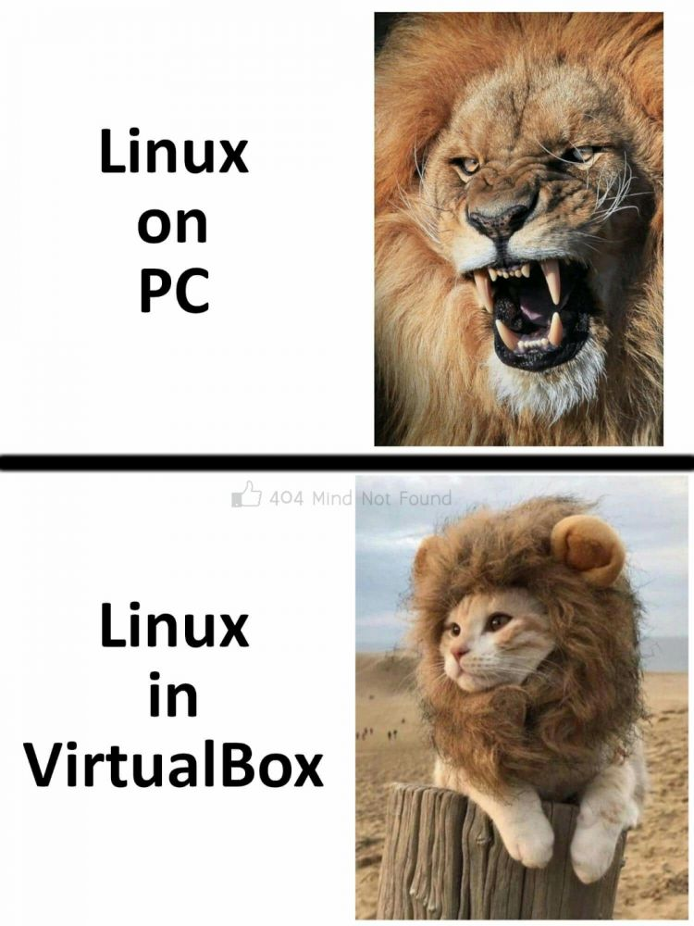
Virtual machine
Compiled by: Pallavi B. Vyas

Slide 20
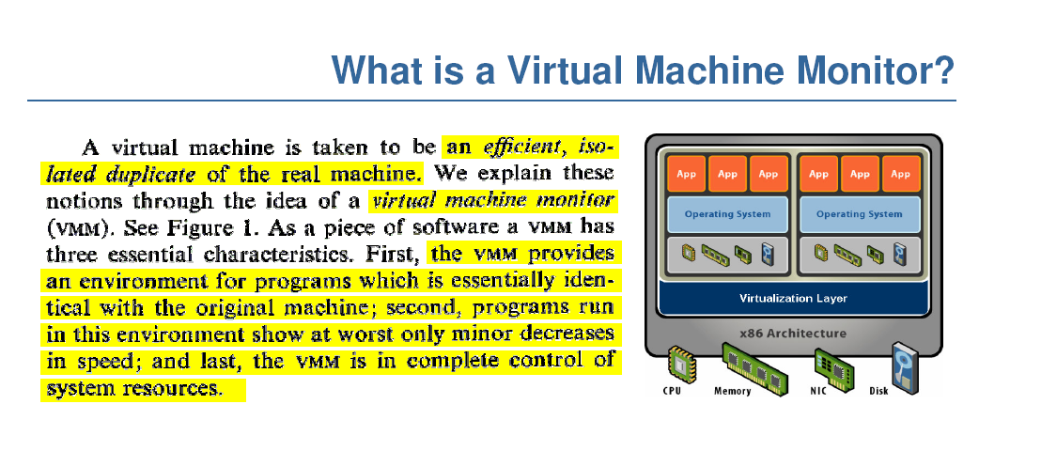
Virtualization of machine
Compiled by: Pallavi B. Vyas

Slide 21
So, it is just like Java VM, right?
Compiled by: Pallavi B. Vyas

Slide 22
Linux Boot Loaders

Slide 23
Linux Boot Loaders
Overview
  A boot loader is a small program that exists in the system and loads the operating system into the system’s memory at system boot. This module deals with two most popular boot loaders of Linux, LILO and GRUB.
Two mainly used:
  Lilo Loader
  Grand Unified Boot Loader
Notes:
boot loader is a program which is responsible to load the O.S

Slide 24
Lilo Loader
Introduction
  LILO or Linux Loader is a boot loader for Linux. A boot loader is a small program that exists in the system and loads the operating system into the system’s memory when the system boots. Boot loader also starts the operating system.

Slide 25
LILO, the Boot Loader
LILO is a flexible boot loader for Linux, which is independent of a file system.
LILO loads itself into the computer’s memory in two stages
  Stage1 – This stage, also known as primary boot loader is read into
  memory by the BIOS from the master boot record
  Stage 2 - This stage, also known as secondary boot loader is read into memory and it displays the Red Hat Linux initial screen
Notes:
LILO stands for linux loader is old boot loader of linux
explain the stages of booting the os

Slide 26
Configuring LILO
To install LILO, it is necessary to know the location of /boot partition.
It is also necessary to know the location of other installed operating systems
LILO can be installed for the first time using a shell script named QuickInst
LILO can be uninstalled using the lilo –u command
Notes:
in case lilo is corrupted , we can reinstall it

Slide 27
Grand Unified Boot Loader
Introduction
  Grand Unified Boot loader or GRUB is a boot loader which operates like LILO and it is presently the default boot loader. GRUB sets the user to select the operating system or kernel to be loaded when a system boots up. It also permits the users to pass arguments.
Notes:
GRUB is the default boot loader in new versions of linux

Slide 28
Some of the important features of GRUB
GRUB has the provision of a true command-based, pre-OS environment on x86 machines.
This will help the user in being more flexible in loading operating systems with denoted options or collecting information about the system
GRUB will support Logical Block Addressing (LBA) mode
ext2 partitions can be read by GRUB.
Notes:
Explain the features of GRUB

Slide 29
GRUB Installation and Configuration
GRUB can be installed during installation and also post installation..
GRUB Configuration
When Grub is installed two configuration files are created and they are
  /boot/grub/grub.conf is the configuration file of GRUB.
  /etc/grub.conf is a link file to /boot/grub/grub.conf and the user can make the configuration changes here
Contd…
Notes:
The main configuration file for GRUB is grub.conf
you can edit this file to set grub password
show demo

Slide 30
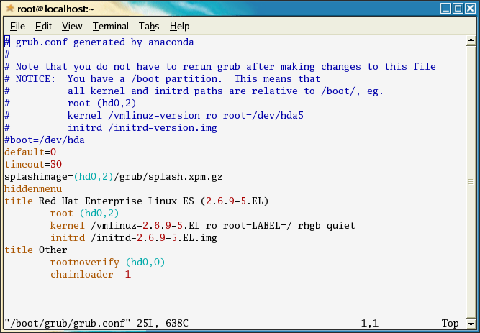
Sample copy of Grub.conf file
Notes:
show demo

Slide 31
Swap Space
Swap space in Linux is used when the amount of physical memory (RAM) is full. If the system needs more memory resources and the RAM is full, inactive pages in memory are moved to the swap space. While swap space can help machines with a small amount of RAM, it should not be considered a replacement for more RAM. Swap space is located on hard drives, which have a slower access time than physical memory.
Compiled by: Pallavi B. Vyas

Slide 32
Swap Space
Swap space can be a dedicated swap partition (recommended), a swap file, or a combination of swap partitions and swap files.
Swap should equal 2x physical RAM for up to 2 GB of physical RAM, and then an additional 1x physical RAM for any amount above 2 GB, but never less than 32 MB.
Compiled by: Pallavi B. Vyas

Slide 33
Example 15.1. Swap RAM
So, if:
M = Amount of RAM in GB, and S = Amount of swap in GB, then
If M < 2
S = M *2
Else
S = M + 2
Using this formula, a system with 2 GB of physical RAM would have 4 GB of swap, while one with 3 GB of physical RAM would have 5 GB of swap. Creating a large swap space partition can be especially helpful if you plan to upgrade your RAM at a later time.
For systems with really large amounts of RAM (more than 32 GB) you can likely get away with a smaller swap partition (around 1x, or less, of physical RAM).
Compiled by: Pallavi B. Vyas

Slide 34
More on Swap space
https://access.redhat.com/documentation/en-US/Red_Hat_Enterprise_Linux/6/html/Storage_Administration_Guide/ch-swapspace.html
Compiled by: Pallavi B. Vyas

